Slide 1



Smart Stock Portfolio Optimizer
(Smart Stock Portfolio Optimizer)
Submitted by
Ishu Barman (2420358)
Vikash Kumar (2420367)
Dharmu kumar (2420353)
Shubham tandon (2330207)

Slide 2
Problem Statement
Smart Stock Portfolio Optimizer: Solve the 0/1 knapsack problem using dynamic programming. Allow users to input item weights, values, and a weight limit.
Develop a 0/1 Knapsack Problem solver using dynamic programming, allowing users to input item weights, values, and weight capacity constraints.
Implement an efficient DP-based approach to determine the maximum achievable value while ensuring the total weight remains within the given limit.
Provide an interactive user interface for seamless input handling, computation, and displaying optimal item selection for maximum profit.

Slide 3
Solution Approach
Develop a simple web interface using HTML and CSS where user can input their values like Weight , Value and Capacity.
Display the optimized result after running the dynamic Knapsack algorithm.
JavaScript will handle the implementation of the dynamic programming logic to compute the optimal item combination efficiently.
Users will input item values, weights, and capacity, and our system will determine the maximum value achievable within constraints.

Slide 4
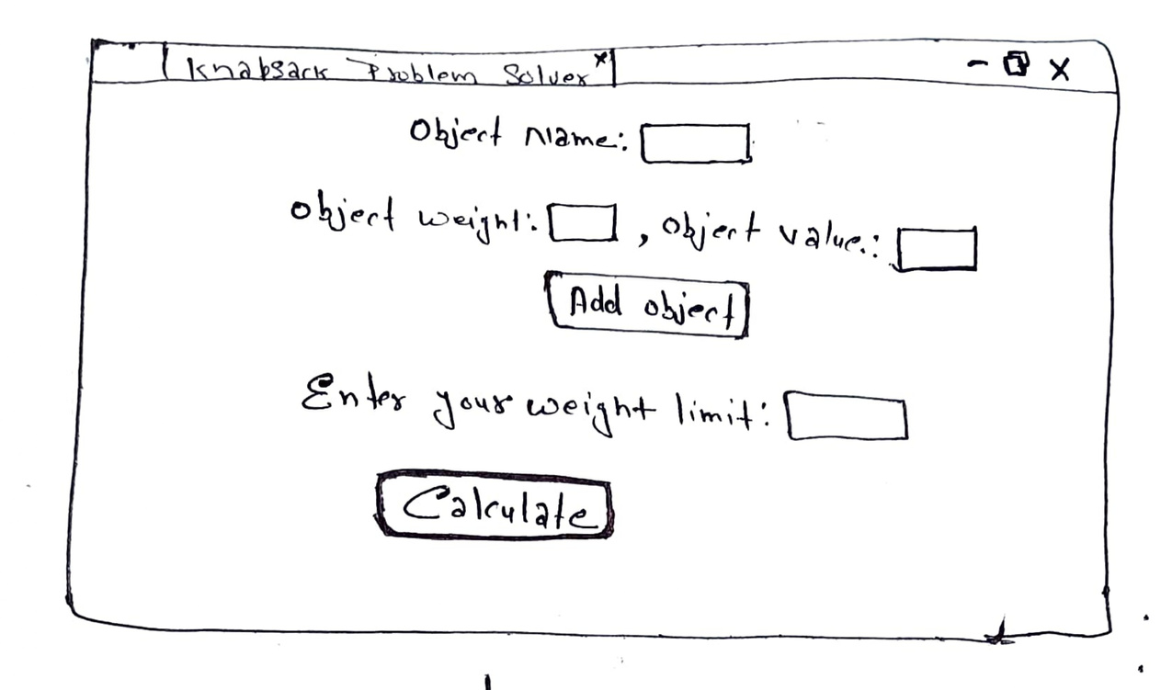
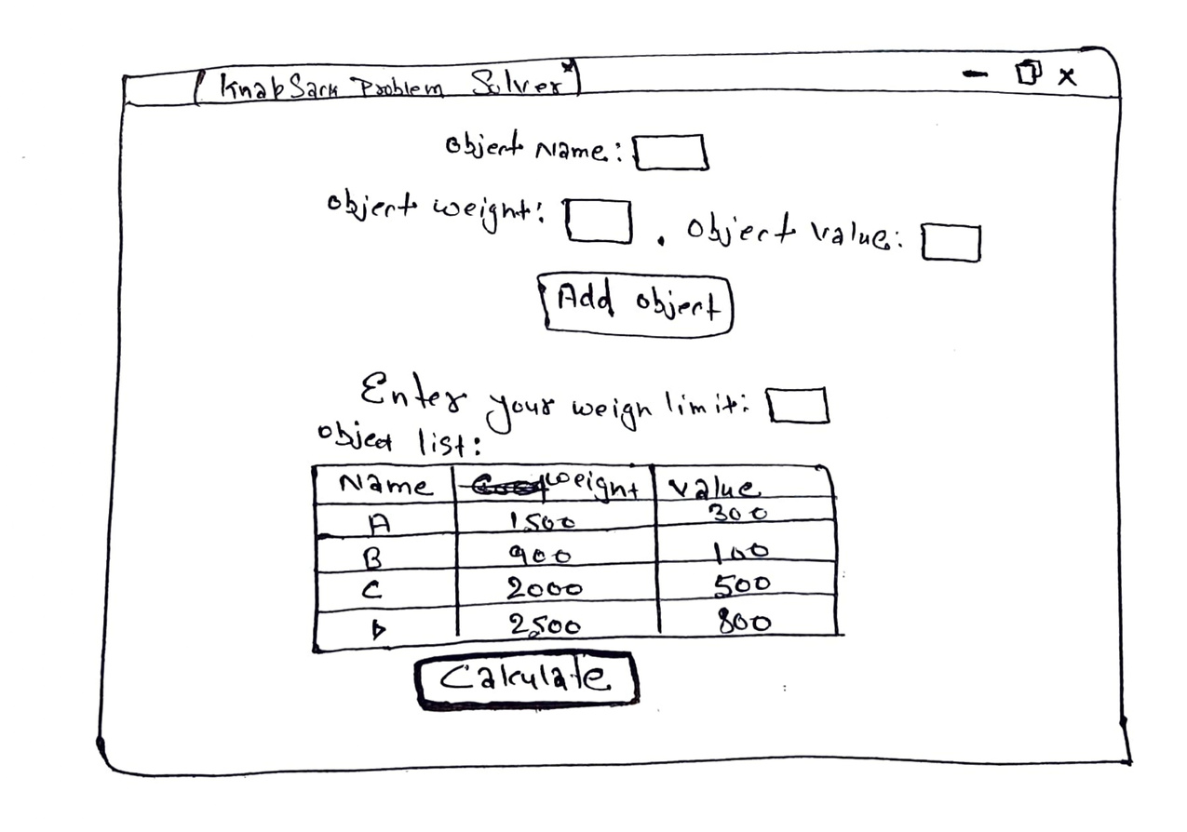
Blueprint of the web-page

Slide 5
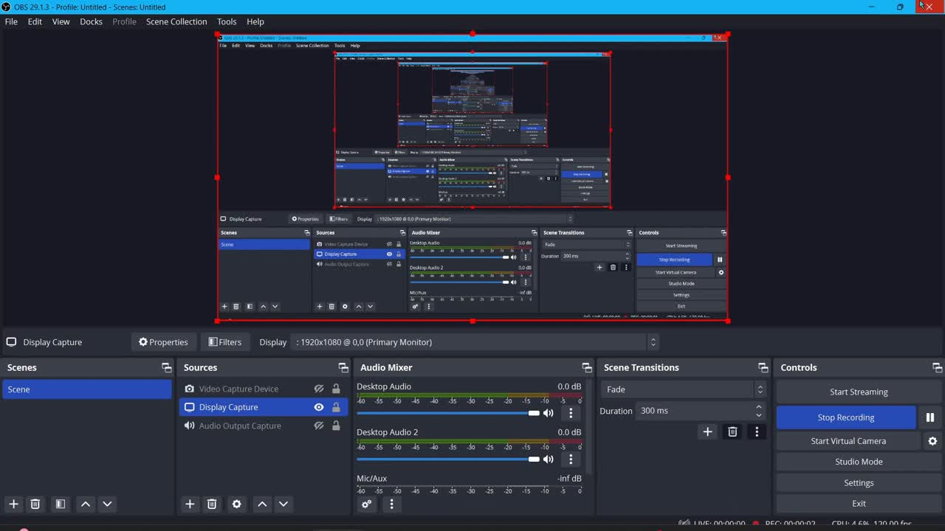
result

Slide 6
Future Scope
Graphical User Interface (GUI).
Data Visualisation
- Pychart.
- Bar-graph/ Line-graph.
User customization option.
Web based application.
Real-Time Market Data Integration

Slide 7
Thank
you!

